Slide 2
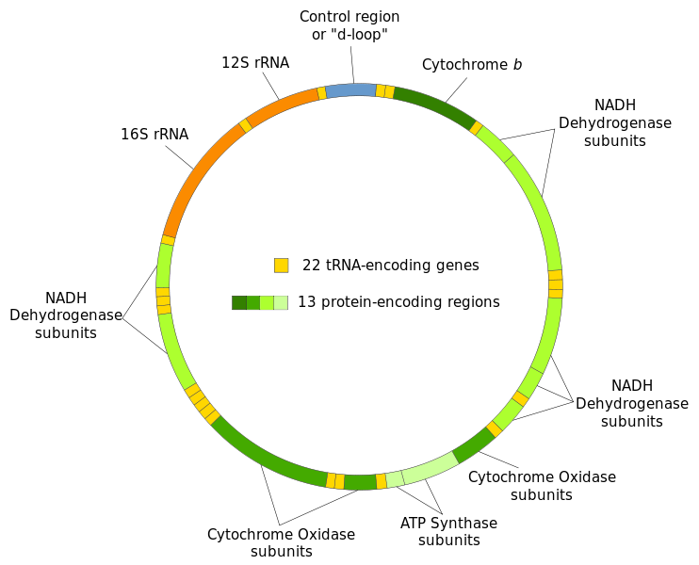

Slide 3
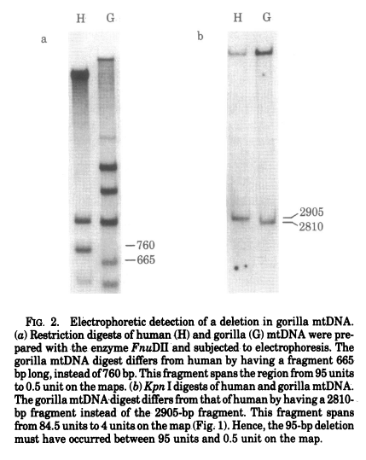
Ferris et al PNAS 1981
Evolutionary tree of apes and humans based on cleavage maps of mtDNA
Figure compares restriction fragments in humans and gorillas for two different enzmes.
Bands change due to point mutations in restriction sites.
A shift in both these patterns corresponds to a 95 bp deletion in Gorilla.

Slide 4
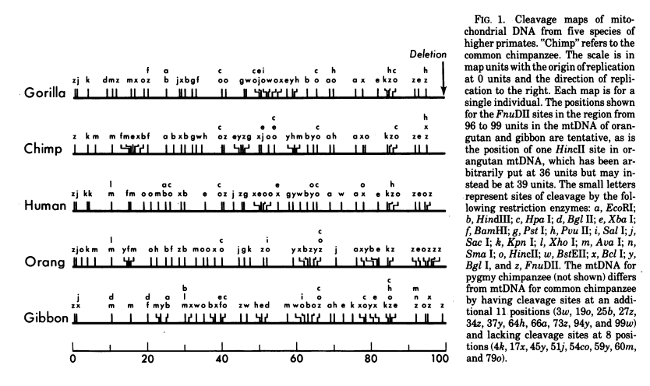
Restriction site map of 5 species
42 sites that are either present or absent in each species

Slide 5
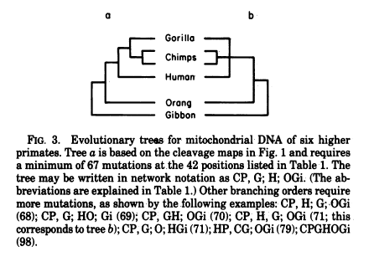
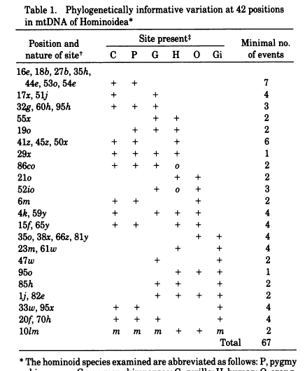
Applying parsimony to restriction sites means finding the tree with the fewest possible changes in the sites.
The most parsimonious tree for these data has 67 mutations in 42 positions.
This places Gorillas and Chimps closer than Humans (almost cetainly wrong).
The alternative tree with Chimps and Humans closer than Gorillas has 68.
This is now thought to be the correct tree using other types of sequence data.

Slide 6
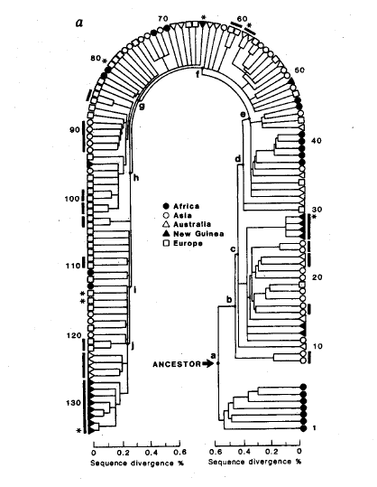
Cann et al, Nature 1987
Mitochondrial DNA and Human Evolution
Parsimony Tree of 134 human mitochondrial sequences
398 mutations in restrictions sites
One of the two primary branches leads exclusively to frican sequences. Suggests an African origin.
Dates of colonization (archaeological)
12000 yrs for New World
30000 yrs for New Guinea
40000 yrs for Australia
Assume constant rate of evolution
Mean rate of evolution is 2%-4% per million years
Hence age of Eve is 140000 – 290000 yrs

Slide 7
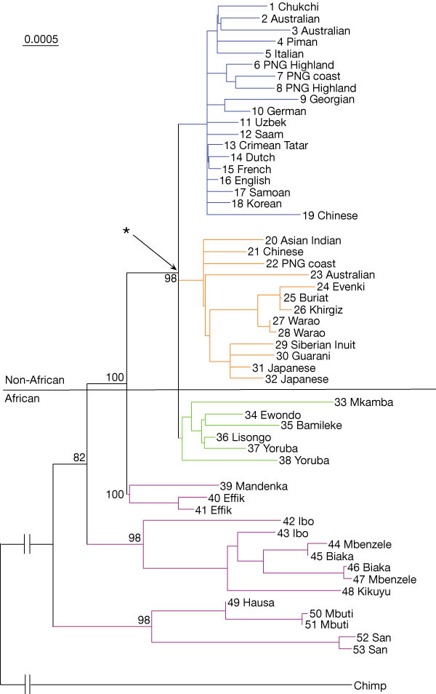
Neighbour-joining phylogram based on complete mtDNA genome sequences (excluding the D-loop).
From
Ingman et al – Nature 2000

Slide 8
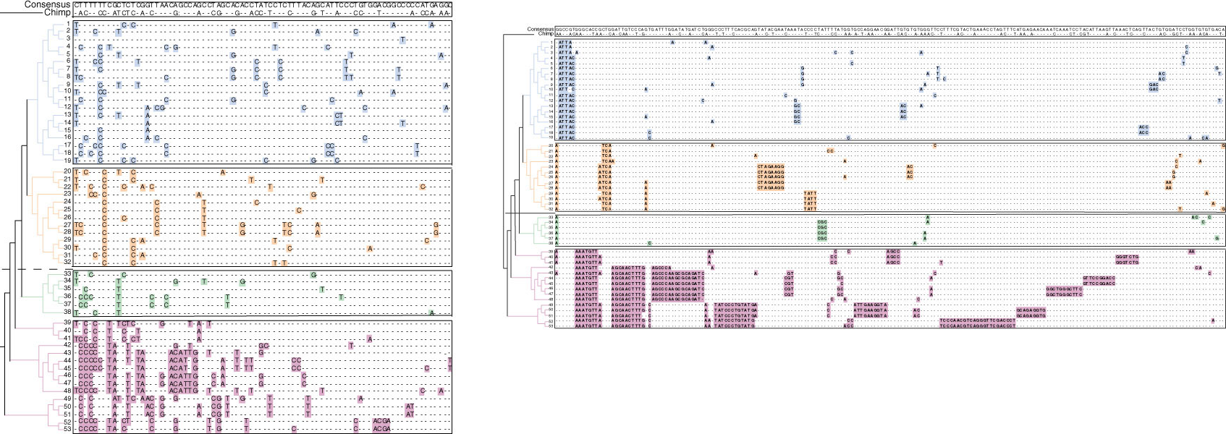
From the mean genetic distance between all the humans and the one chimpanzee sequence (0.17 substitutions per site) and the assumption, based on palaeontological¹⁰ and genetic¹¹ evidence, of a divergence time between humans and chimpanzees of 5 Myr, the mutation rate () for the mitochondrial molecule, excluding the D-loop, is estimated to be 1.70 10 ⁻⁸ substitutions per site per year.
This is 0.017 per million years – close to 2% per million years in the previous paper

Slide 9
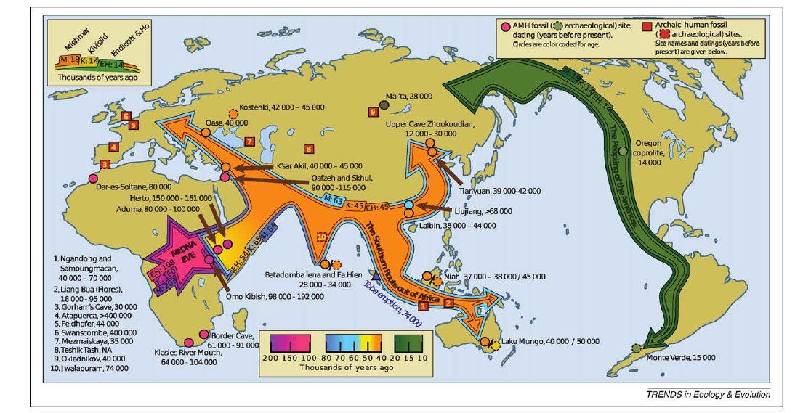
Endicott et al – Trends in Ecol and Evol (2009)
Deducing human migration pathways from fossils and reconciling with genetic evidence

Slide 10
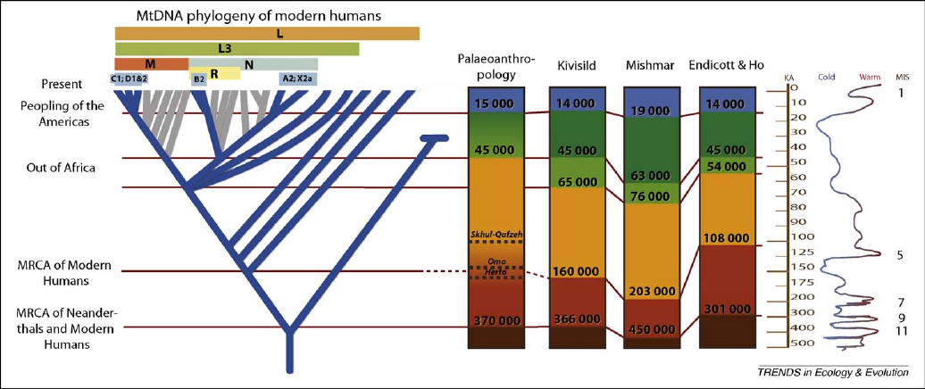
Endicott et al – Trends in Ecol and Evol (2009)
Dating the important branchpoints on the tree depends on rate calibrations.
Still difficult to do precisely

Slide 11
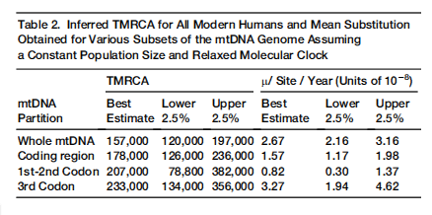
A revised timescale for human evolution based on ancient mitochondrial genomes.
Fu et al (2013) Current Biology
Sequence fragments of mtDNA from a fossil specimen and assemble the genome.
Radiocarbon dating to get the age of the sample. Gives good calibration.
Otherwise – the date of the human chimp split is much farther back (5-7 million years) and is much less certain.

Slide 12
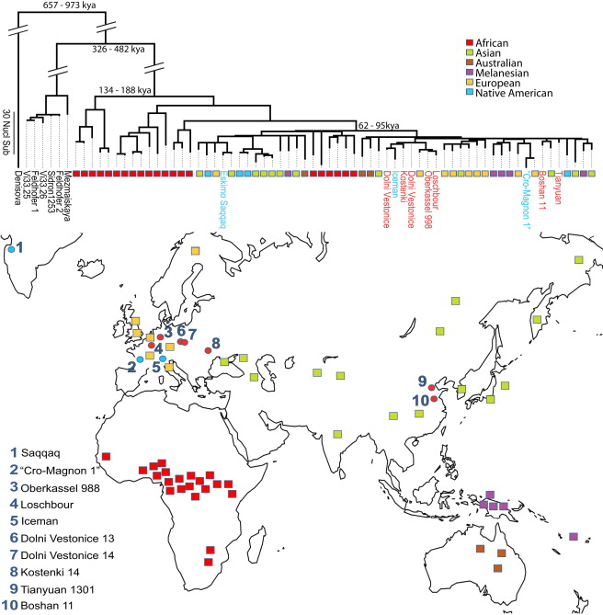

Slide 13
Selection is also important
Apparently faster evolution on more recent branches

