Slide 1
Cosmology and a
Massive Graviton
Adam R. Solomon
Center for Particle Cosmology,
University of Pennsylvania
Princeton/IAS Cosmology Lunch
April 22nd, 2016

Slide 2
Collaborators
Yashar Akrami
Luca Amendola
Jonas Enander
Fawad Hassan
Tomi Koivisto
Frank Könnig
Edvard Mörtsell
Mariele Motta
Malin Renneby
Angnis Schmidt-May

Slide 3
The cosmological constant problem is hard
Old CC problem: why isn’t the CC enormous?
  Vacuum energy induces large CC
  Universe accelerates long before structure can form
New CC problem: why isn’t it zero?
  The Universe is accelerating! Implies tiny but non-zero CC
  Require technical naturalness, otherwise reintroduce old CC problem

Slide 4
The CC problem is a problem of gravity
Particle physics tells us the vacuum energy, and gravity translates that into cosmology
The CC affects gravity at ultra-large distances, where we have few complementary probes of GR
Does the CC problem point to IR modifications of GR?
Can address the old problem, new problem, or both

Slide 5
Modifying gravity is also hard
Notes:
And I’ve left this slide blank so I can demonstrate the point with a picture

Slide 7
Modifying gravity is also hard
It is remarkably tricky to move away from GR in theory space
Ghosts/instabilities
Long-range fifth forces

Slide 8
Massive gravity is a promising way forward
Conceptual simplicity
  GR: unique theory of a massless spin-2
  Mathematical simplicity? Depends on your aesthetics
Has potential to address both CC problems
  Old CC problem: degravitation
    Yukawa suppression lessens sensitivity of gravity to CC
    Degravitation in LV massive gravity: work in progress (with Justin Khoury, Jeremy Sakstein)
Technically natural small parameter
  Graviton mass protected by broken diffs

Slide 9
How to build a massive graviton
Step 1: Go linear
Consider a linearized metric
The Einstein-Hilbert action at quadratic order is
with the Lichnerowicz operator defined by
This action is invariant under linearized diffeomorphisms

Slide 10
How to build a massive graviton
Step 1: Go linear
Unique healthy (ghost-free) mass term
(Fierz and Pauli, 1939):
This massive graviton contains five polarizations:
  2 x tensor
  2 x vector
  1 x scalar
Fierz-Pauli tuning: Any other coefficient between and leads to a ghostly sixth degree of freedom

Slide 11
dRGT Massive Gravity in a Nutshell
The unique non-linear action for a single massive spin-2 graviton is
where f_{μν} is a reference metric which must be chosen at the start
β_{n} are interaction parameters; the graviton mass is ~m²β_{n}
The e_{n} are elementary symmetric polynomials given by…

Slide 12
For a matrix X, the elementary symmetric polynomials are ([] = trace)

Slide 13
An aesthetic aside
The potentials in the last slide are ugly
Lovely structure in terms of vielbeins and differential forms:

Slide 14
Much ado about a reference metric?
There is a simple (heuristic) reason that massive gravity needs a second metric: you can’t construct a non-trivial interaction term from one metric alone:
We need to introduce a second metric to construct interaction terms.
Can be Minkowski, (A)dS, FRW, etc., or even dynamical
This points the way to a large family of theories with a massive graviton

Slide 15
Theories of a massive graviton
Examples of this family of massive gravity theories:
g_{μν}, f_{μν} dynamical: bigravity (Hassan, Rosen: 1109.3515)
  One massive graviton, one massless
g_{μν}, f_{1,μν}, f_{2,μν}, …, f_{n,μν}, with various pairs coupling à la dRGT: multigravity (Hinterbichler, Rosen: 1203.5783)
  n-1 massive gravitons, one massless
Massive graviton coupled to a scalar (e.g., quasidilaton, mass-varying)

Slide 16
The search for viable massive cosmologies
No stable FLRW solutions in dRGT massive gravity
Way out #1: large-scale inhomogeneites
Way out #2: generalize dRGT
  Break translation invariance (de Rham+: 1410.0960)
  Generalize matter coupling (de Rham+: 1408.1678)
Way out #3: new degrees of freedom
  Scalar (mass-varying, f(R), quasidilaton, etc.)
  Tensor (bi/multigravity) (Hassan/Rosen: 1109.3515)

Slide 17
Massive bigravity has self-accelerating cosmologies
Consider FRW solutions
NB: g = physical metric (matter couples to it)
Bianchi identity fixes X
New dynamics are entirely controlled by y = Y/a

Slide 18
Massive bigravity has self-accelerating cosmologies
The Friedmann equation for g is
The Friedmann equation for f becomes algebraic after applying the Bianchi constraint:

Slide 19
Massive bigravity has self-accelerating cosmologies
At late times, ρ → 0 and so y → const.
The mass term in the Friedmann equation approaches a constant – dynamical dark energy

Slide 20
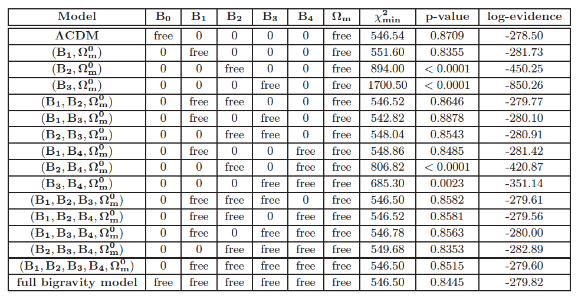
Massive bigravity vs. ΛCDM
Y. Akrami, T. Koivisto, and M. Sandstad [arXiv:1209.0457]
See also F. Könnig, A. Patil, and L. Amendola [arXiv:1312.3208];
ARS, Y. Akrami, and T. Koivisto [arXiv:1404.4061]

Slide 21
Beyond the background
Cosmological perturbation theory in massive bigravity is a huge cottage industry and the source of many PhD degrees. See:
Cristosomi, Comelli, and Pilo, 1202.1986
ARS, Akrami, and Koivisto, 1404.4061
Könnig, Akrami, Amendola, Motta, and ARS, 1407.4331
Könnig and Amendola, 1402.1988
Lagos and Ferreira, 1410.0207
Cusin, Durrer, Guarato, and Motta, 1412.5979
and many more for more general matter couplings!

Slide 22
Scalar perturbations in massive bigravity
Our approach (1407.4331 and 1404.4061):
Linearize metrics around FRW backgrounds, restrict to scalar perturbations {E_{g,f}, A_{g,f}, F_{g,f}, and B_{g,f}}:
Full linearized Einstein equations (in cosmic or conformal time) can be found in ARS, Akrami, and Koivisto, arXiv:1404.4061

Slide 23
Scalar fluctuations can suffer from instabilities
Usual story: solve perturbed Einstein equations in subhorizon, quasistatic limit:
This is valid only if perturbations vary on Hubble timescales
Cannot trust quasistatic limit if perturbations are unstable
Check for instability by solving full system of perturbation equations

Slide 24
Scalar fluctuations can suffer from instabilities
Degree of freedom count: ten total variables
  Four g_{μν} perturbations: E_{g}, A_{g}, B_{g}, F_{g}
  Four f_{μν} perturbations: E_{f}, A_{f}, B_{f}, F_{f}
  One perfect fluid perturbation: χ
Eight are redundant:
  Four of these are nondynamical/auxiliary (E_{g}, F_{g}, E_{f}, F_{f})
  Two can be gauged away
  After integrating out auxiliary variables, one of the dynamical variables becomes auxiliary – related to absence of ghost!
End result: only two independent degrees of freedom
NB: This story is deeply indebted to Lagos and Ferreira

Slide 25
Scalar fluctuations can suffer from instabilities
Choose g-metric Bardeen variables:
Then entire system of 10 perturbed Einstein/fluid equations can be reduced to two coupled equations:
where

Slide 26
Scalar fluctuations can suffer from instabilities
Ten perturbed Einstein/fluid equations can be reduced to two coupled equations:
where
Under assumption (WKB) that F_{ij}, S_{ij} vary slowly, this is solved by
with N = ln a

Slide 27
Scalar fluctuations can suffer from instabilities
B₁-only model – simplest allowed by background
Unstable for small y (early times)
NB: Gradient instability

Slide 28
A = -\[Beta]1 + 3/\[Beta]1;y[a_] := (1/6) a^-3 (-A + Sqrt[12 a^6 + A^2])ParametricPlot[{1/a - 1, y[a]} /. \[Beta]1 -> 1.38, {a, 1/6, 1}, AspectRatio -> .8, PlotTheme -> "Detailed", FrameLabel -> {z, y}, PlotLegends -> None, ImageSize -> Large, LabelStyle -> {FontFamily -> "Latin Modern Roman", FontSize -> 20, FontColor -> RGBColor[0, 0.01, 0]}]

Slide 29
Scalar fluctuations can suffer from instabilities
B₁-only model – simplest allowed by background
Unstable for small y (early times)
For realistic parameters, model is only (linearly) stable for z <~ 0.5

Slide 30
Instability does not rule models out
Instability → breakdown of linear perturbation theory
  Nothing more
  Nothing less
Cannot take quasistatic limit
Need nonlinear techniques to make structure formation predictions

Slide 31
Do nonlinearities save us?
Helicity-0 mode of the massive graviton has nonlinear derivative terms (cf. galileons)
Linear perturbation theory misses these
Some evidence that the gradient instability is cured by these nonlinearities! (Aoki, Maeda, Namba 1506.04543)
  Morally related to the Vainshtein mechanism
How can we study nonlinear perturbations in detail?

Slide 32
Strategy for “quasilinear” perturbations
Bigravity’s degrees of freedom:
  1 massive graviton (two helicity-2, two helicity-1, one helicity-0)
  1 massless graviton (two helicity-2)
Goal: keep nonlinearities in spin-0 mode while leaving other fluctuations linear

Slide 33
Cosmology as a perturbation of flat space
Helicity decomposition only well-defined around flat background
Q: How can we isolate helicity-0 mode in cosmological perturbations?
A: Use Fermi normal coordinates, for which

Slide 34
Cosmology as a perturbation of flat space
Starting from the FRW metric in comoving coordinates,
the coordinate change
yields

Slide 35
Cosmology as a perturbation of flat space
So within the horizon we can write FRW as Minkowski space plus a small perturbation,

Slide 36
Bimetric Fermi normal coordinates
In bigravity with two FRW metrics,
we clearly need two different Fermi coordinates.
Fermi coordinates Φª for f metric. Method: start with f-metric comoving coordinates Φ_{c}ª such that
and then build FNC Φª from Φ_{c}ª as in previous slide
We identify Φª as the Stückelberg fields associated to broken diff invariance

Slide 37
Bimetric Fermi normal coordinates
The FNC for the bimetric FRW backgrounds are related by the helicity-0 Stückelberg,

Slide 38
To the decoupling limit
This is all suggestive of the decoupling limit of bigravity:
with Λ₃³ = m²M_{Pl}, and take the scaling limit
while keeping Λ₃, M_{Pl}/M_{f}, and β_{n} fixed
DL leaves leading interactions between helicity modes

Slide 39
The decoupling limit
The action in the DL is
The first two terms are linearized Einstein-Hilbert, and
where

Slide 40
Cosmological perturbations in the decoupling limit
The DL equations of motion yield correct background cosmological equations ✓
Nonlinear subhorizon structure formation by perturbing in DL
Can consistently keep χ_{μν} and w_{ab} linear while retaining nonlinearities in φ and ψ!

Slide 41
Example: β₂-only model
The action in the DL is
Perturb to second order:
Can be fully diagonalized:

Slide 42
Example: β₂-only model
This leaves us with (after int by parts, removing dual galileon)
where the coefficients of the kinetic and gradient terms are
c_{k}>0 is equivalent to the Higuchi bound: useful consistency check! NB β₂ is not a linearly unstable model

Slide 43
Summary
Massive gravity is a promising approach to the cosmological constant problems
Bimetric massive gravity has cosmological backgrounds competitive with ΛCDM
These models have linear instabilities
A deeper look into quasilinear behavior of perturbations can shed light on endpoint of instability
Resuscitate massive (bi)gravity as a target for observations?

