Slide 1
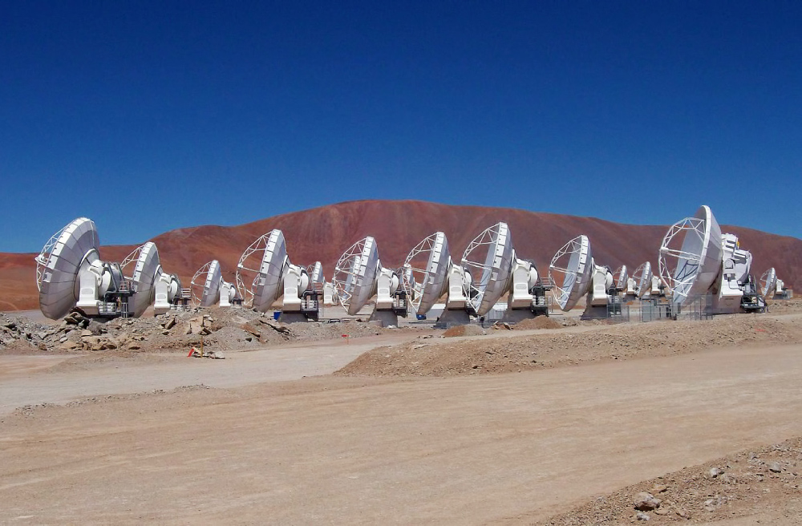
Becoming a radio astronomer
Chris Wilson
McMaster University
January 27, 2023

Slide 2


Outline
Introduction
  My path into radio astronomy
  What we can learn from millimetre wavelength observations of galaxies
The Atacama Large Millimeter Array
Star-forming gas clouds in two nearby galaxy mergers: observations and simulations
Summary
With research support from
  NSERC (research grants, student scholarships)
  The Ontario Government (student scholarships)
  The Canada Research Chairs program
  NRC (ALMA construction and operations)
  CFI (ALMA construction)

Slide 3
My path to radio astronomy
1980-1984: B.Sc. in Physics and Astronomy at UofT
  One of 3 women in a class of 30 graduates
  Had considered doing Engineering Science program
1984-1985: summer research x 2, 3 months as volunteer in Cote d’Ivoire
1985-1990: Ph.D. in Astronomy at Caltech
1990-1992: Postdoctoral researcher at University of Maryland
Professor at McMaster University since 1992

Slide 4
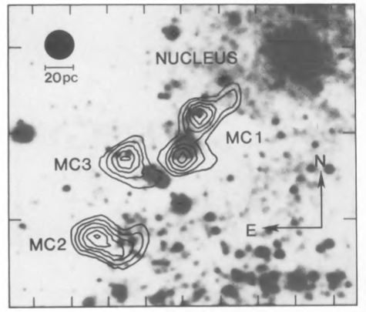
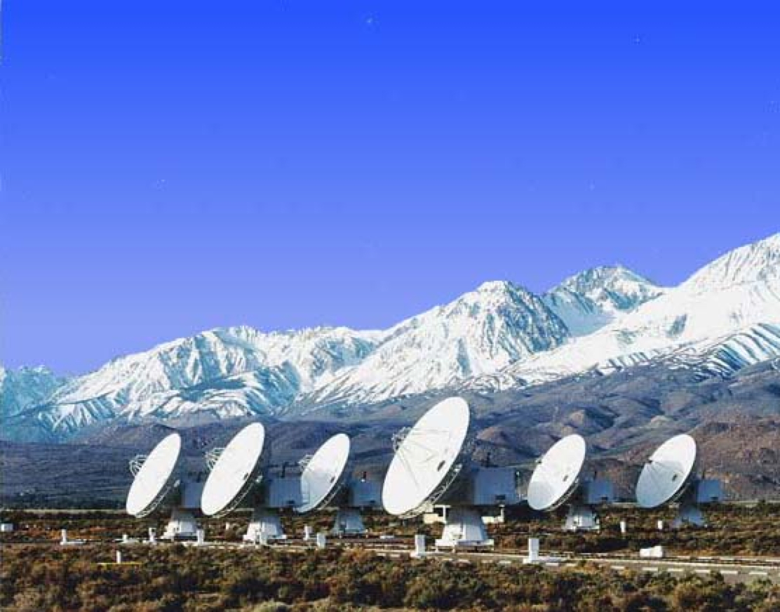
My first radio project: cold dense clouds of gas in M33 with the Owens Valley Millimeter Array
60 light years
Wilson, Scoville et al., 1988, Astrophysical Journal
(the array only had 3 antennas at the time!)

Slide 5

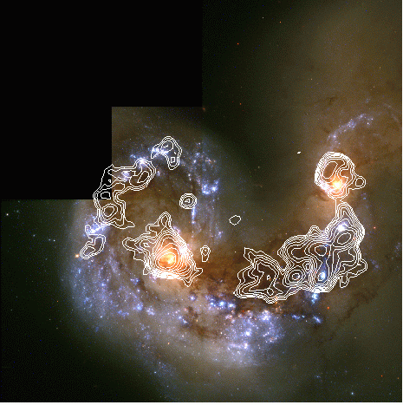

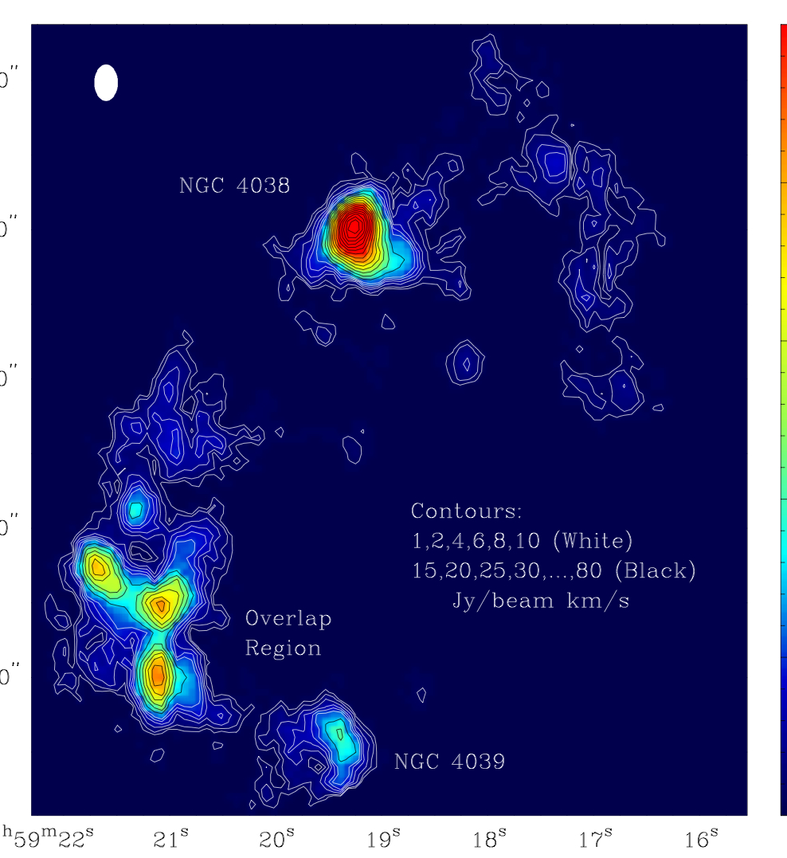
My first sabbatical: Super-giant gas clouds in a merging galaxy
900x1500 l.y.
Wilson et al., 2000;
HST image Whitmore et al. 1999

Slide 6
2020
1999
3000 l.y.
OVRO data: Wilson et al., 2000
ALMA data: Brunetti, Wilson, et al. (in preparation)

Slide 7
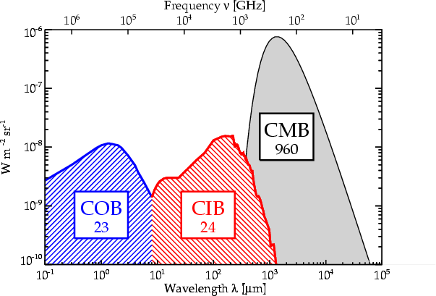
Importance of the Millimetre/Infrared
ALMA covers the submillimetre peak and pushes into the IR tail
Half of the energy created in the Universe since the CMB has been reprocessed into the Infrared (IR)
These photons dominate the spectrum of planets, young stars, and many distant galaxies
Notes:
Include diagram of the cosmic background spectrum xray thru radio
Perhaps that of the MW Galaxy??
Could show where mm/submm lies in em spectrum
ALMA’s wavelength range--a few human hairs to a stack of five dimes.

Slide 8
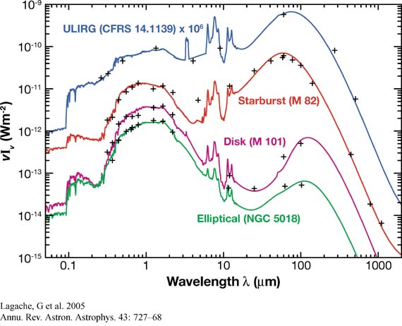
The distribution of energy in galaxies
Where ALMA observes
Galliano 2004
PhD thesis, Paris

Slide 9
The gas that lies between the stars
Gas can be ionized, atomic, or molecular
  H and He with traces of C, N, O and everything else
H₂ is the phase that forms stars
  Typically cold (10-50 K) and dense (>10²/cm³)
  but doesn’t emit (J=2 level needs T~200 K to be significantly populated)
CO second most abundant molecule
  easy to excite rotational transitions by collisions with H₂ for T > 5 K
  CO traces total molecular gas in galaxies

Slide 10
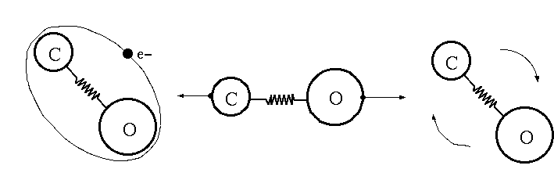
Cold gas (10-50 K): emission lines from molecules
Molecules emit energy in discrete narrow energy ranges via rotational, vibrational, or electronic transitions
  H₂ does not produce emission lines unless the temperature is much higher (roughly 200 K)
  use rarer molecules like CO as tracers
(Figure courtesy
Albert Nummelin
Chalmers
University)

Slide 11
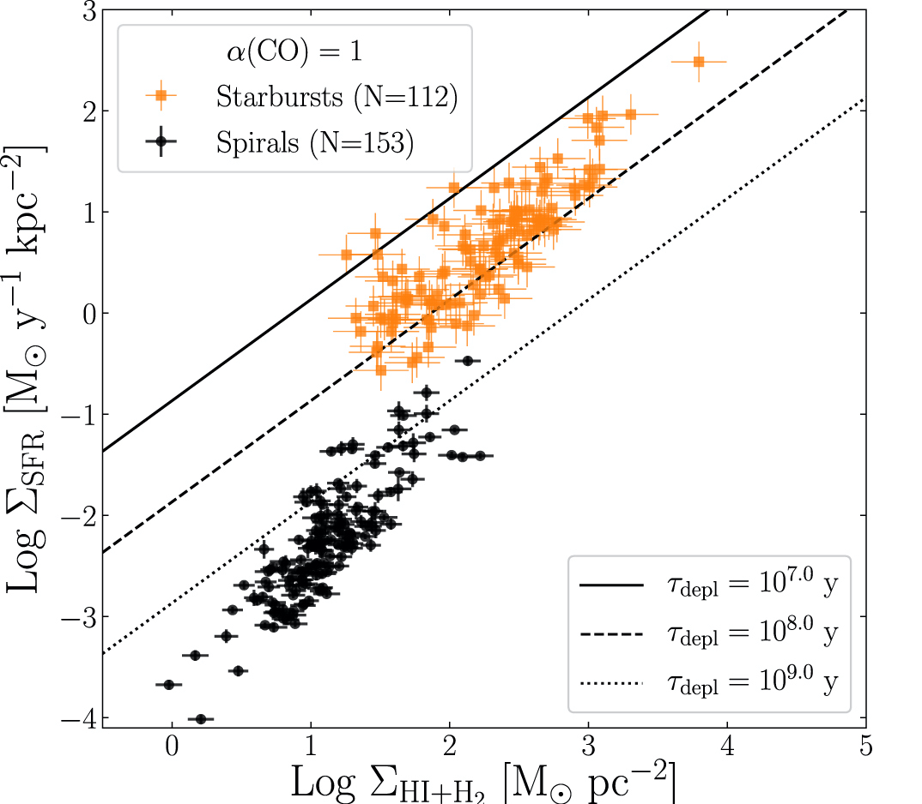
Correlation between star formation and gas in galaxies
Total star formation correlates strongly with total gas content in spiral galaxies (black points) (Kennicutt & de los Reyes 2021)
Gas is converted into stars significantly faster in starburst galaxies (orange points)
Time to deplete the gas is much shorter in starburst galaxies

Slide 12

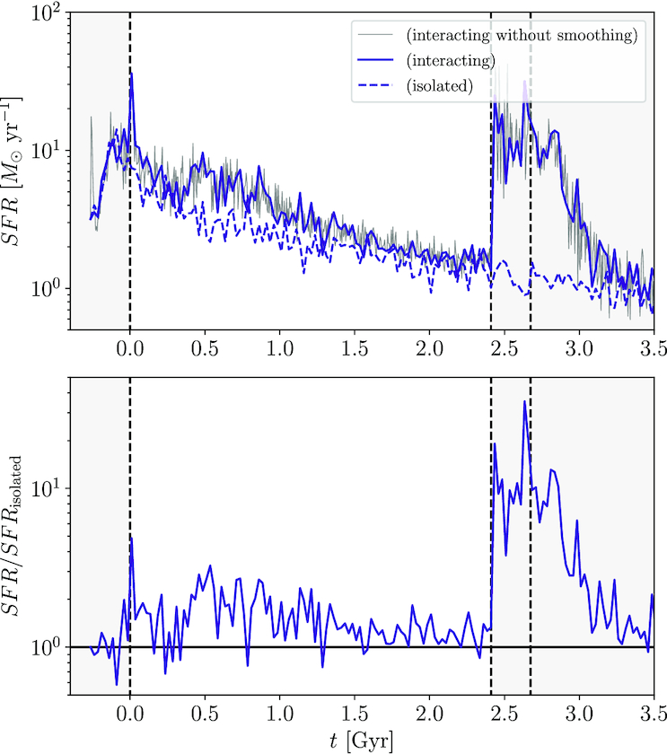
Simulations show star formation rate in galaxy mergers varies with time
Star formation rate (solar masses per year)
FIRE simulations: Moreno et al. 2019, MNRAS
Time since first passage (billions of years)

Slide 13
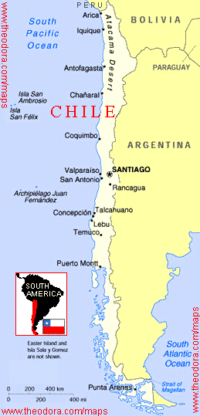
ALMA: the Atacama Large Millimeter Array
A global partnership: North America, Europe, East Asia, Chile
5000m (16,500 ft) site in Chilean Atacama desert
Main Array: 50 x 12m-diameter antennas
  + Total Power Array 4 x 12m
  + Atacama Compact Array (12 x 7m-diameter antennas)

Slide 14
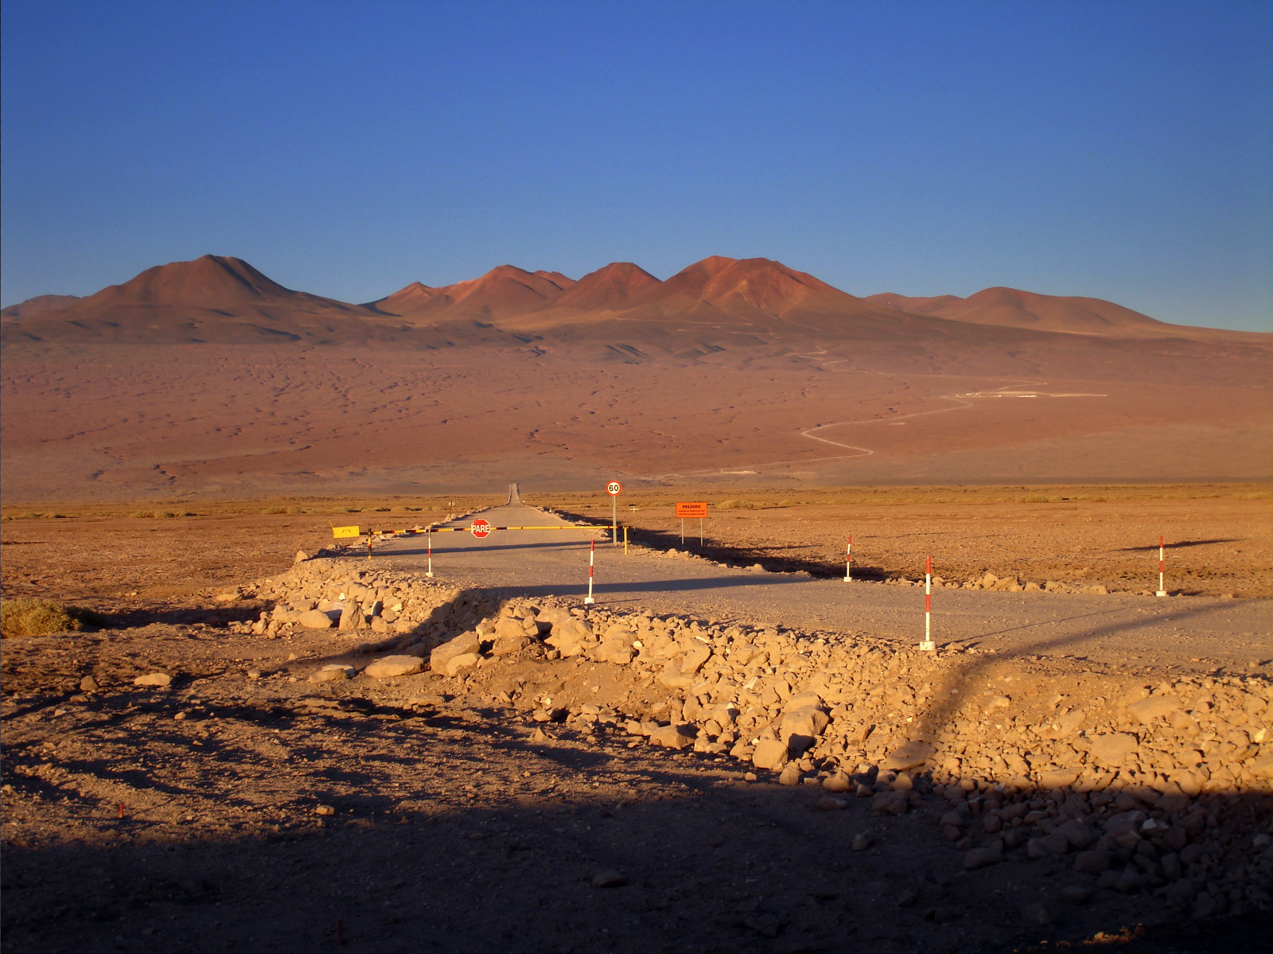
The Road To ALMA
43 km to Array Operations Site (AOS)
5,000m elevation
15 km to Operations Support Facility (OSF)
2,900m elevation
1414
Notes:
1414

Slide 15
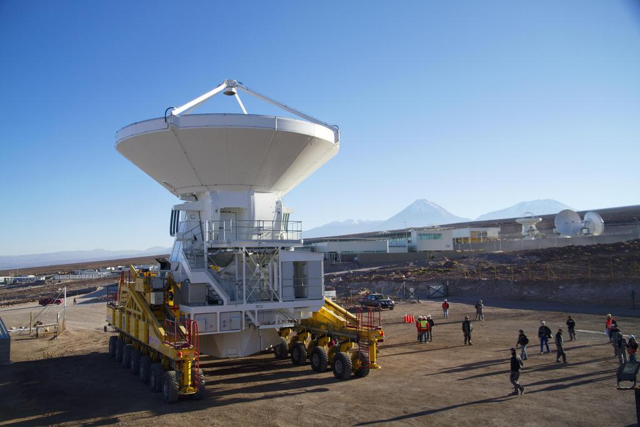
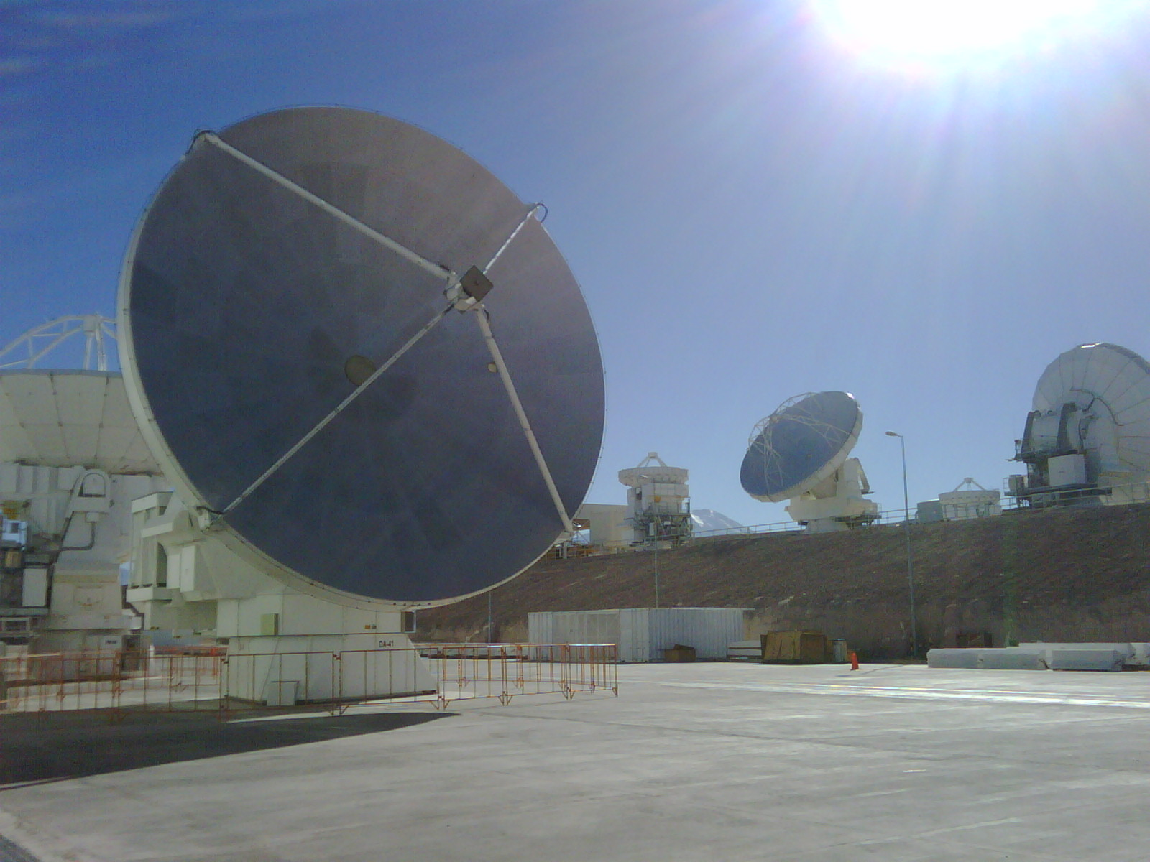
First European antenna
(21 April 2011)

Slide 16
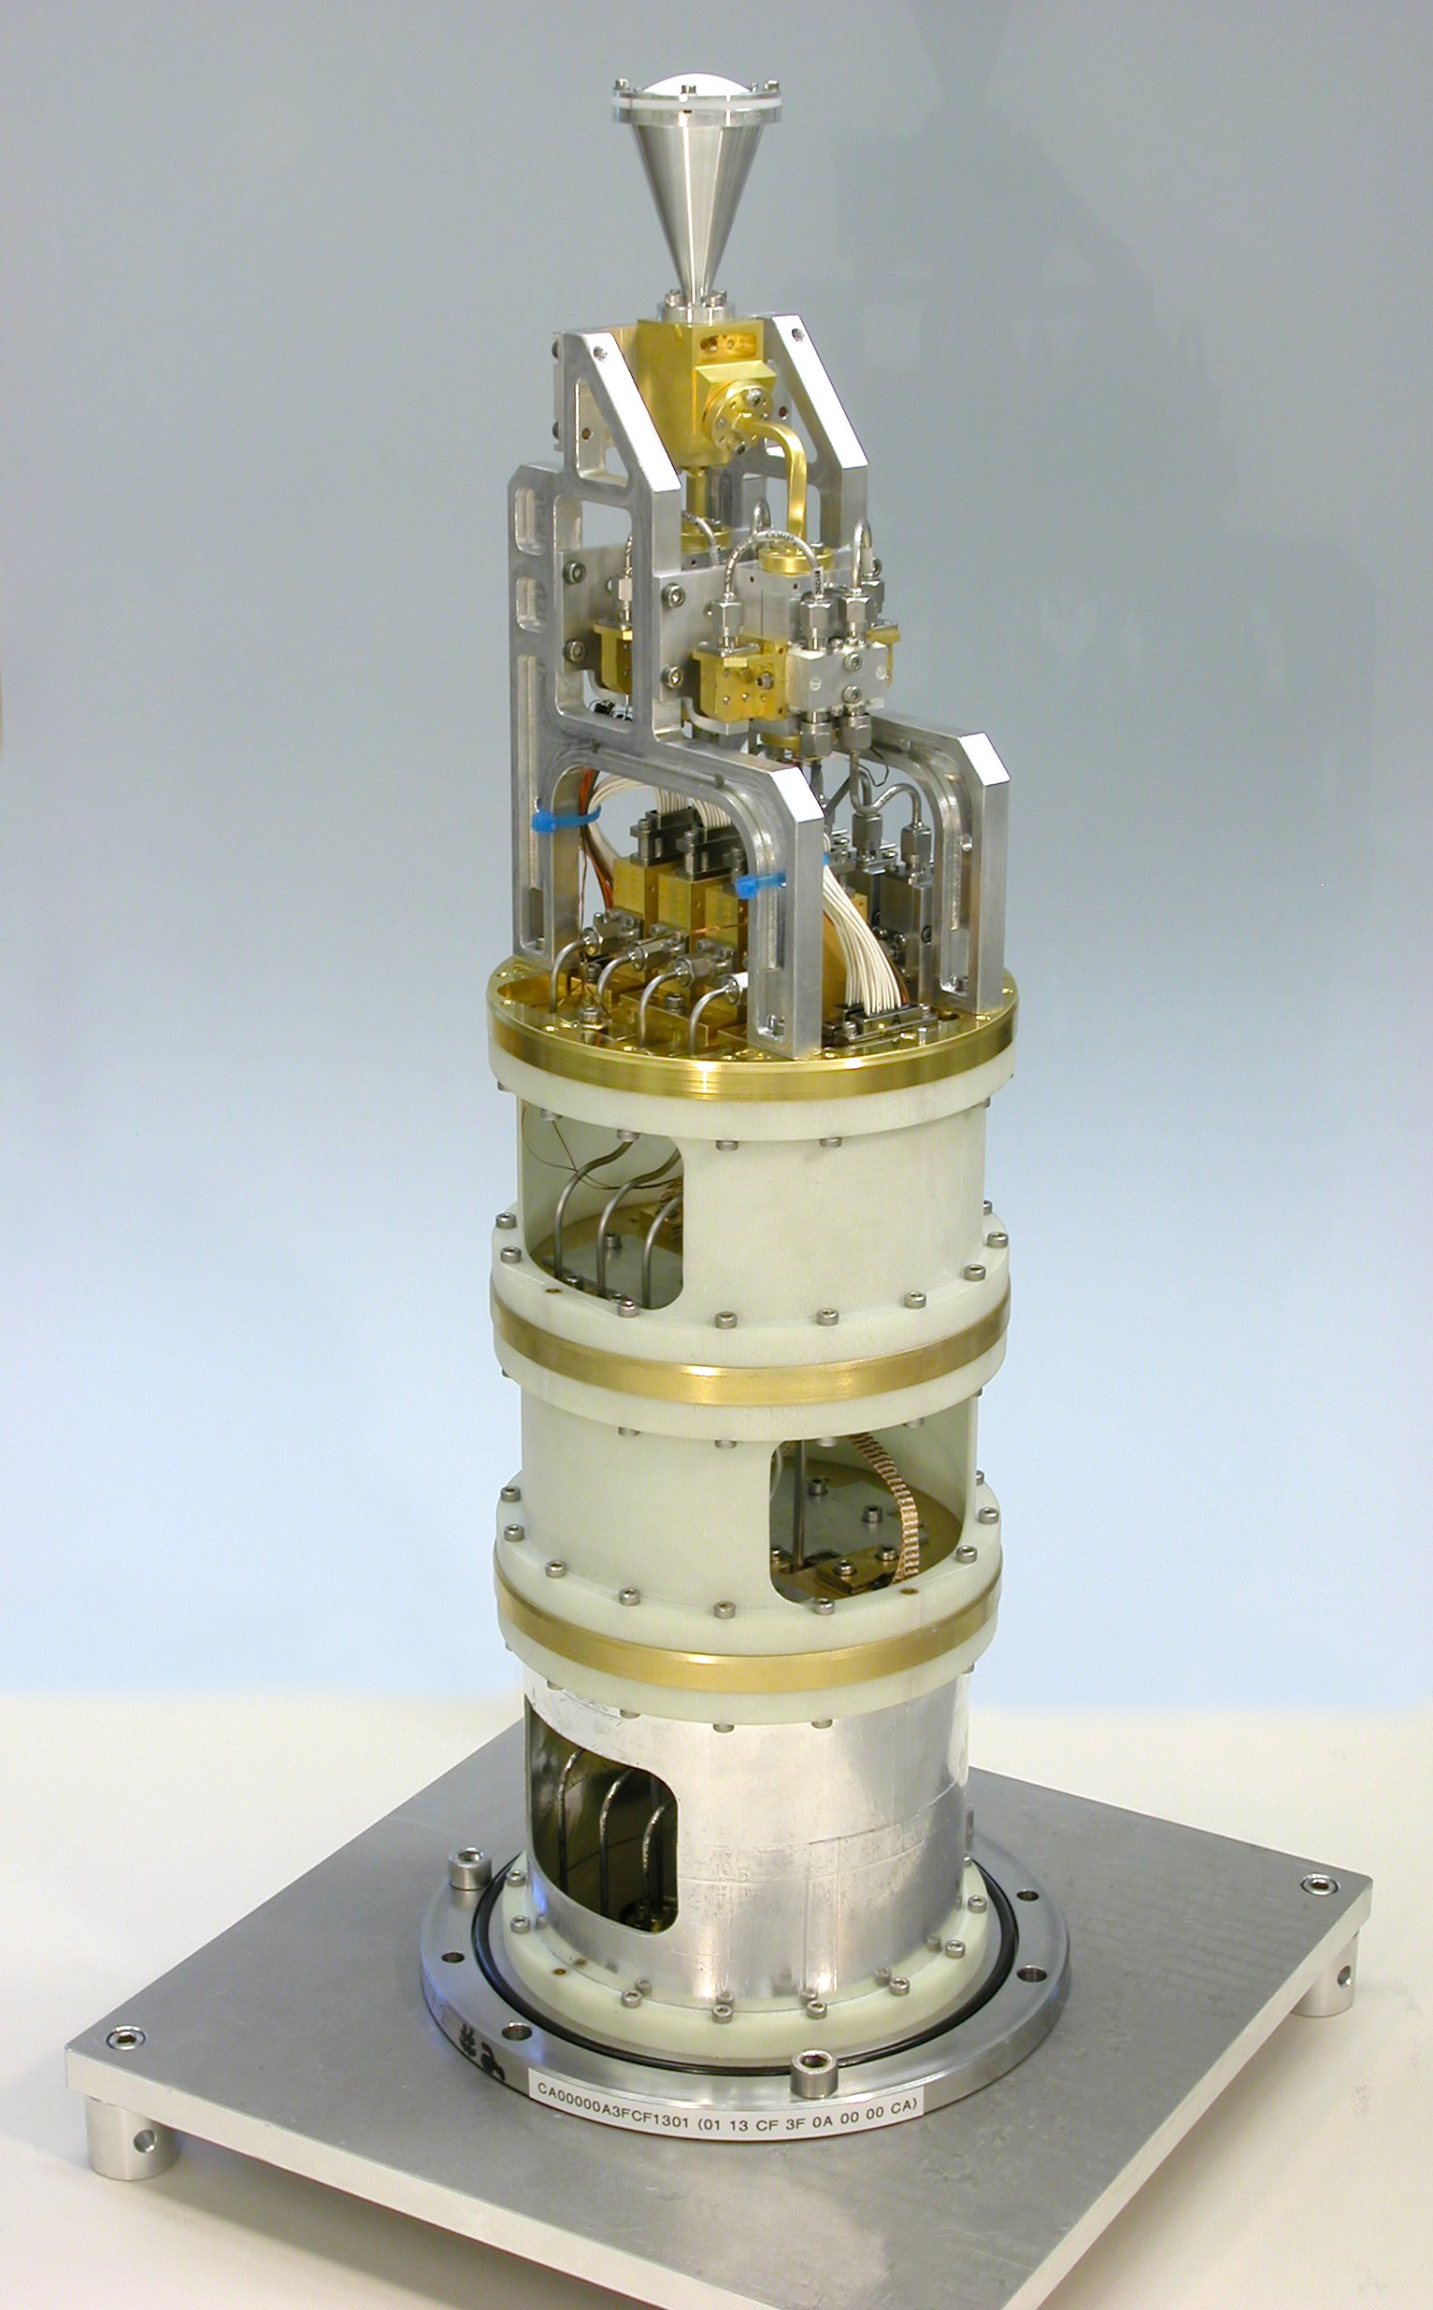
ALMA Band 3 (3 mm or 100 GHz)
Lens
Feed Horn
OMT
Pol1 2SB Mixer
Assembly
Pol0 2SB Mixer
Assembly
IF Amplifiers
and Isolators
ALMA Requirement
built by NRC’s
Herzberg Institute
of Astrophysics
in Victoria B.C.
4 K Stage
15 K Stage
300 K Vacuum
Flange
80 K Stage
Major sub-components contracted out to Canadian industry

Slide 17
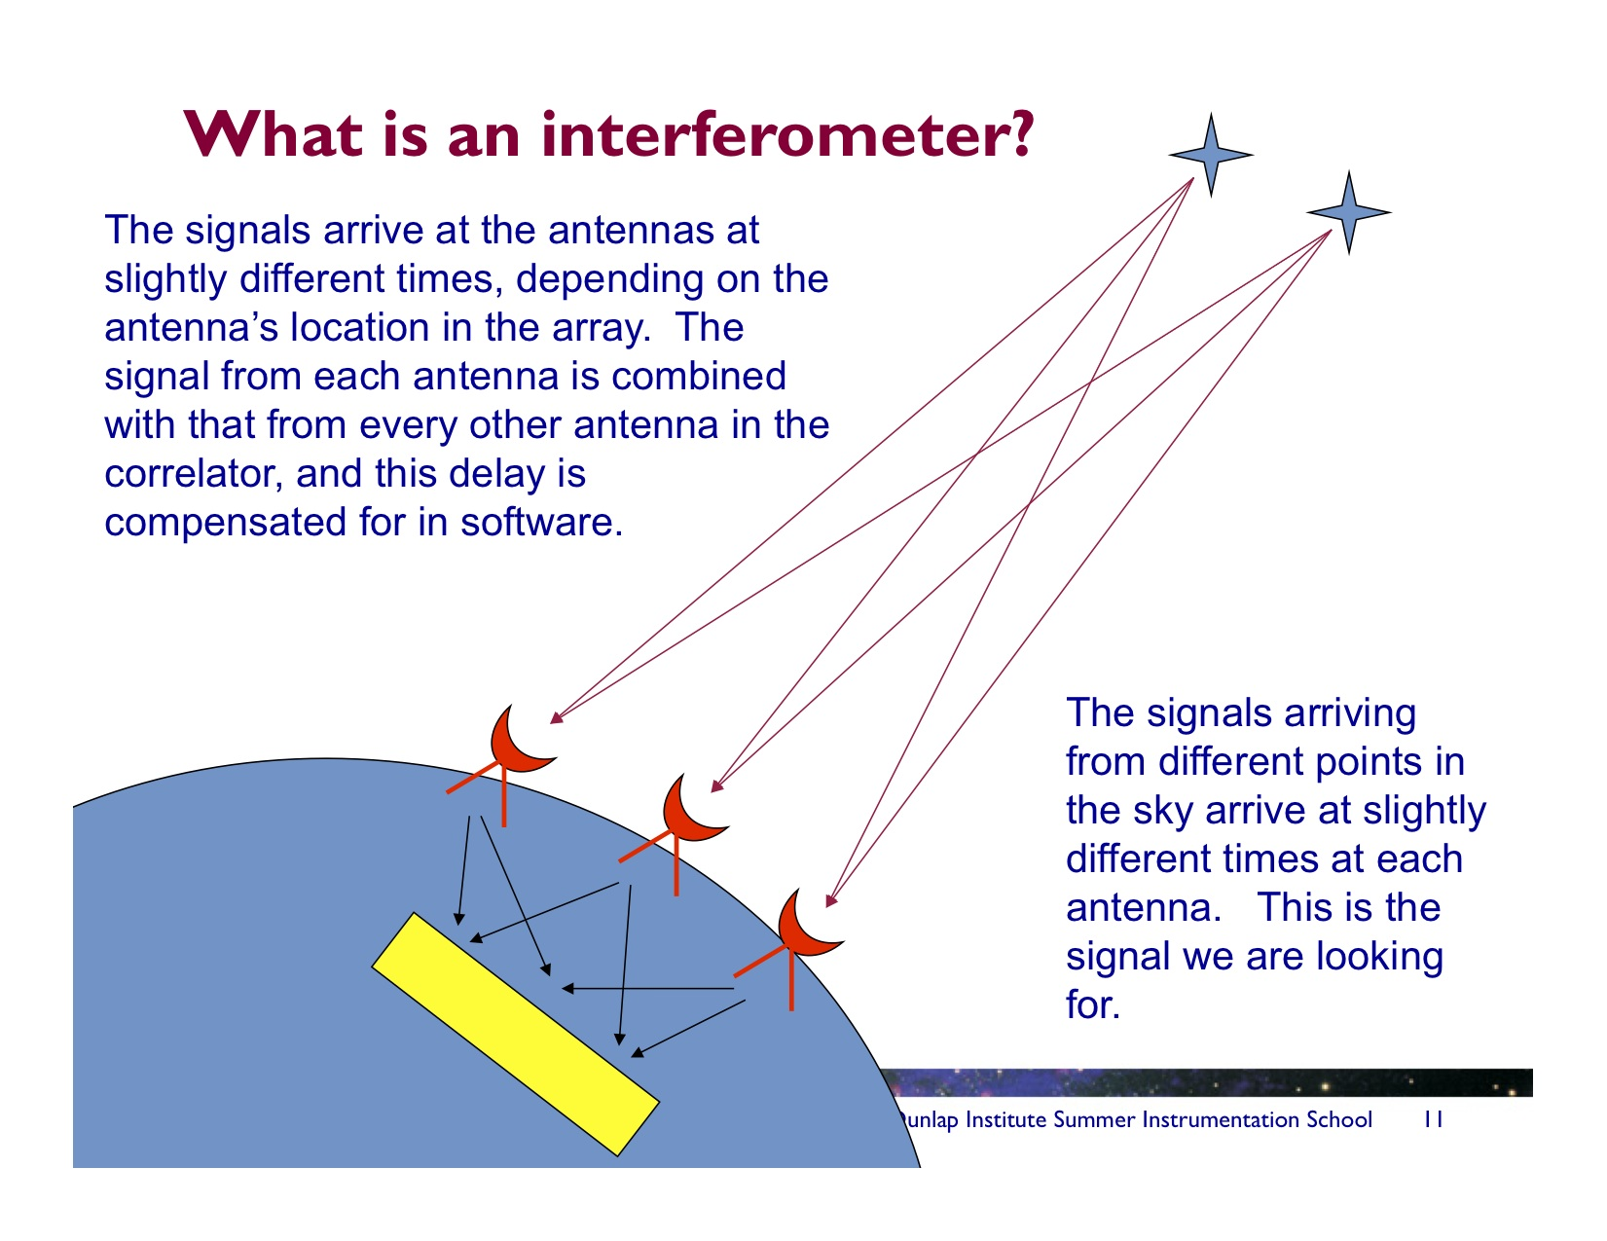
(slides courtesy
Alison Peck, NRAO)

Slide 18
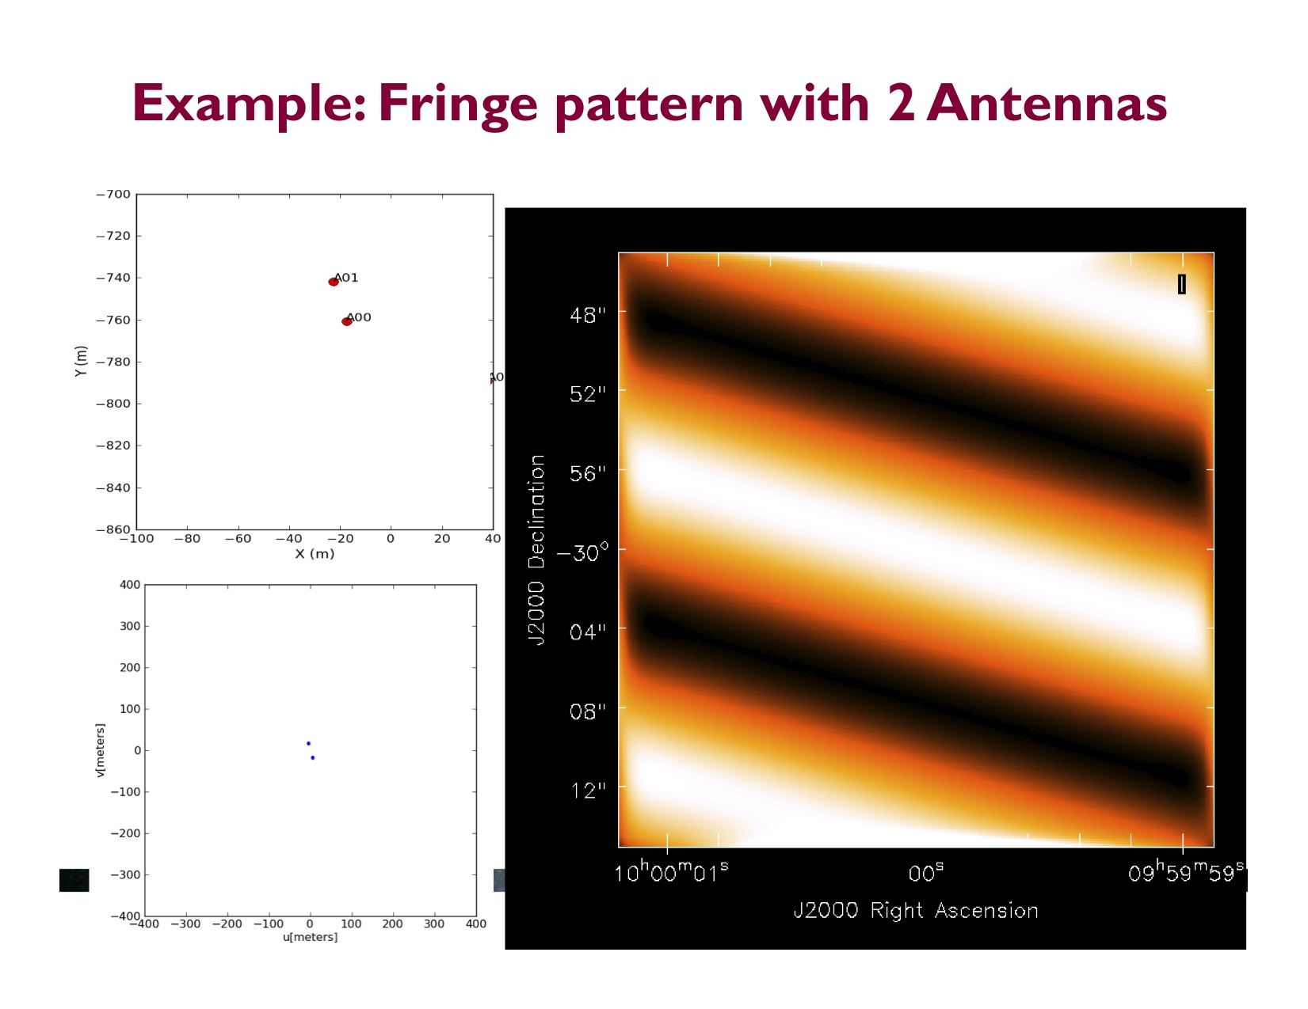

Slide 19
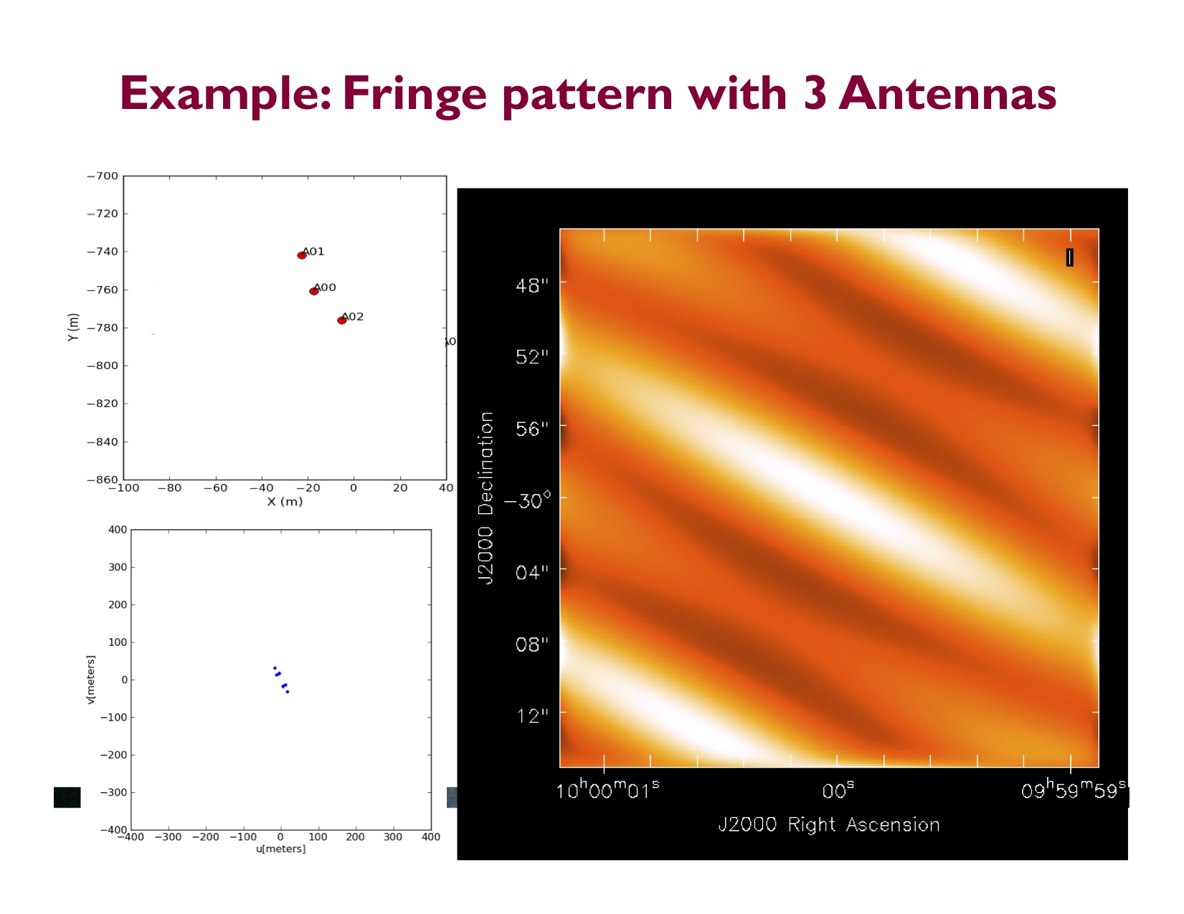

Slide 20
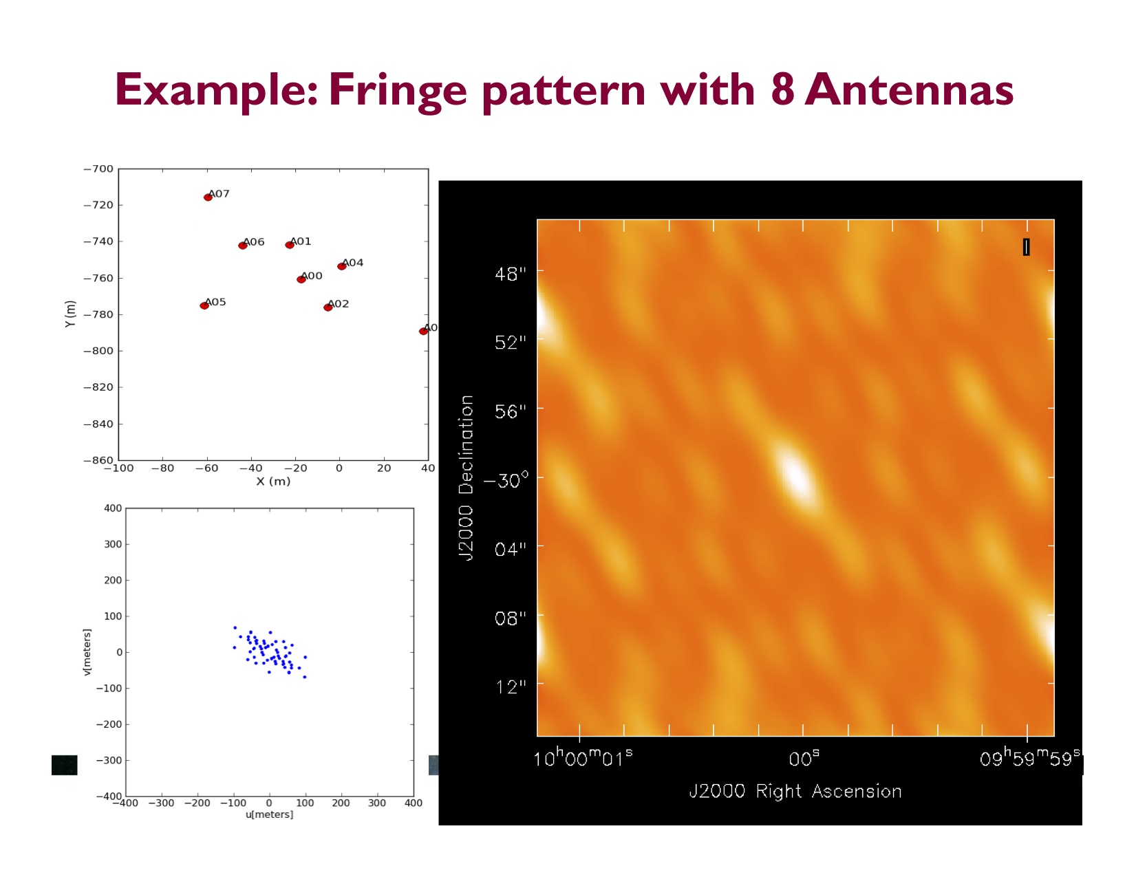

Slide 21


Slide 22


Slide 23
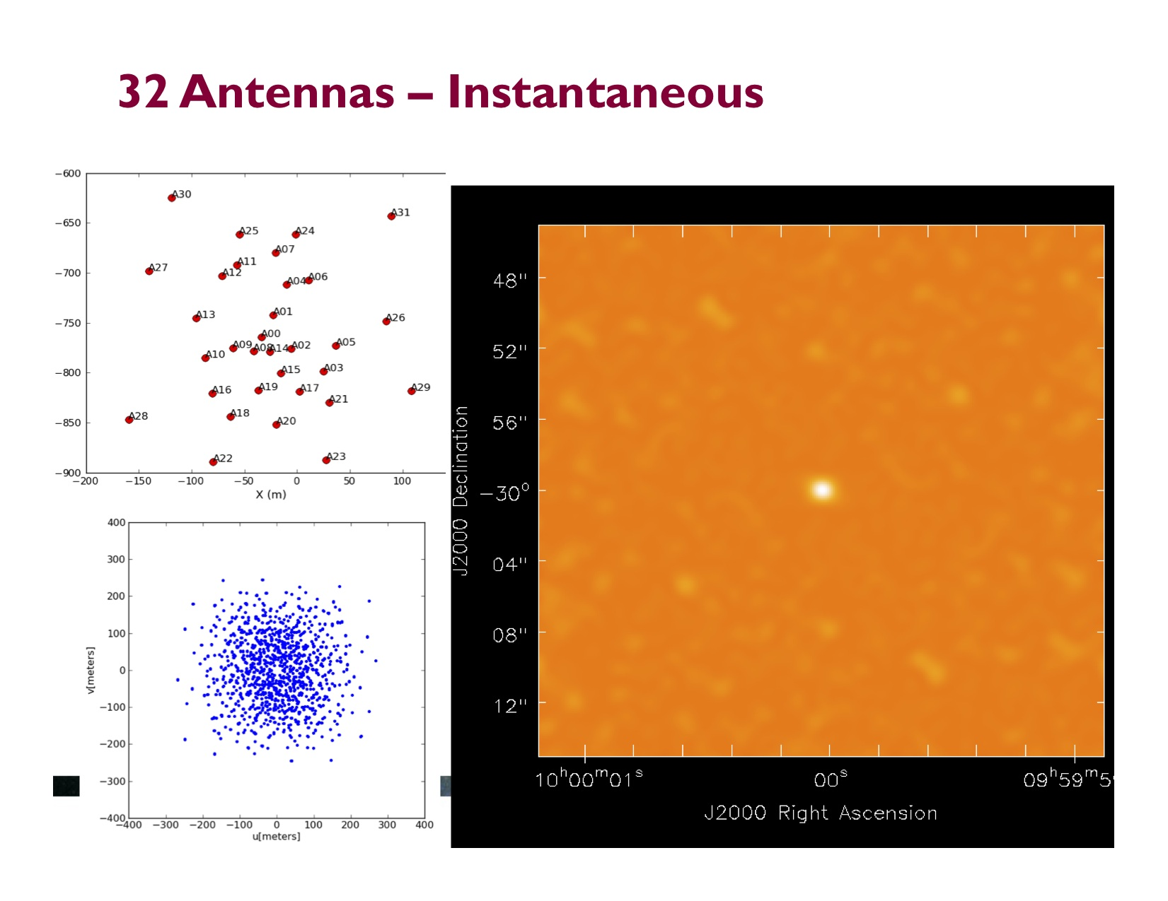

Slide 24
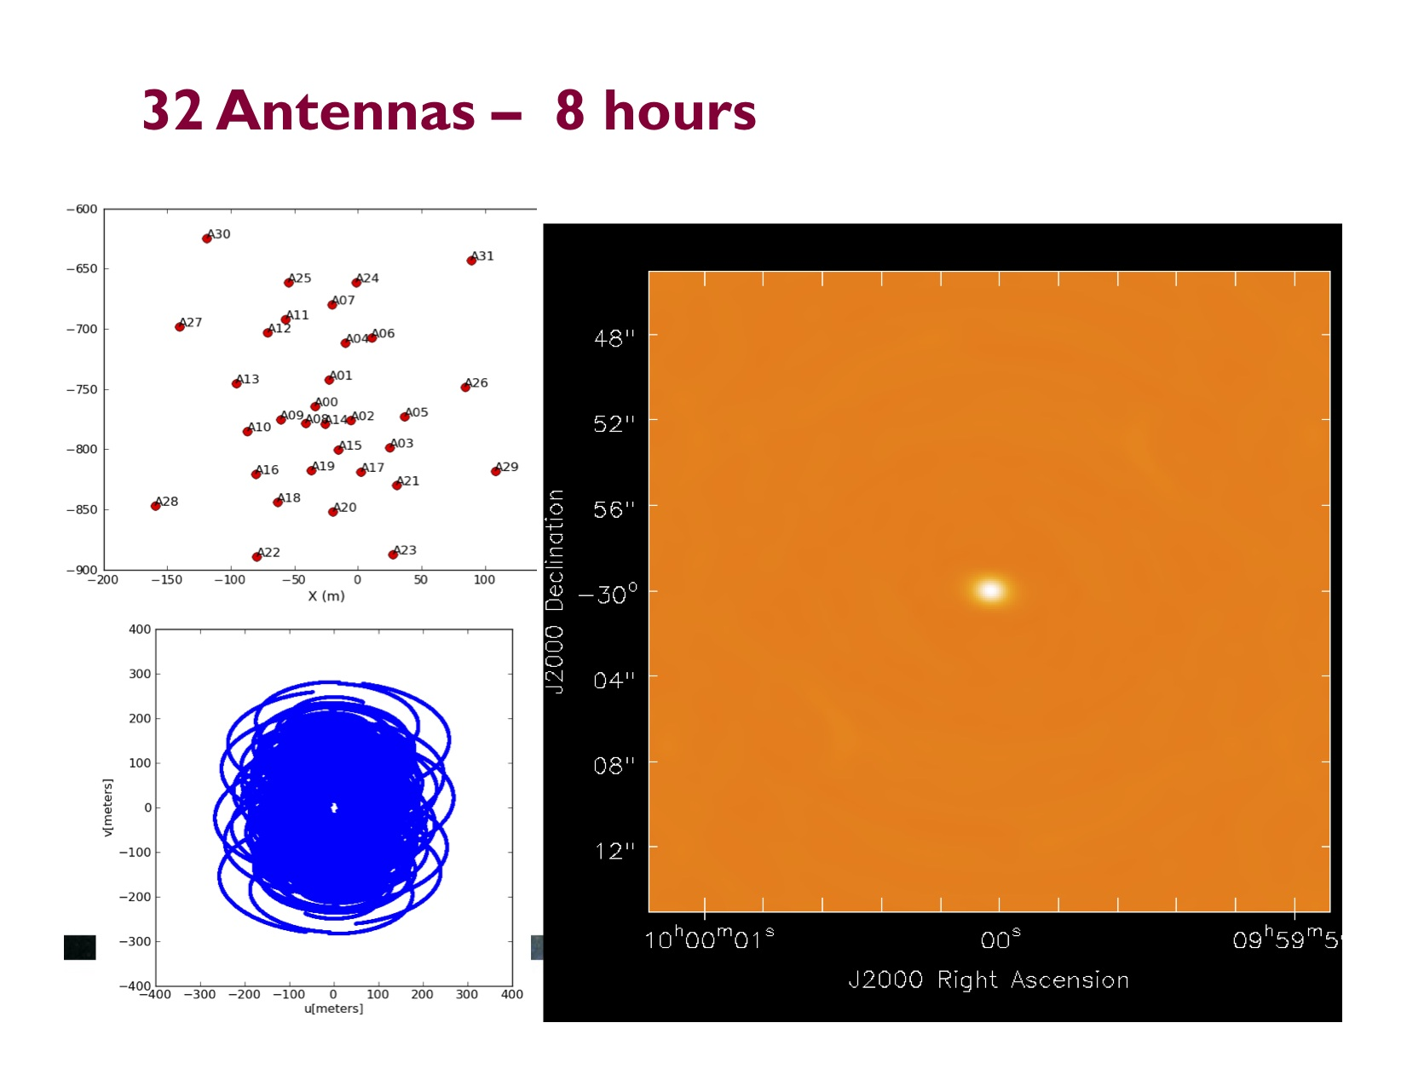

Slide 25
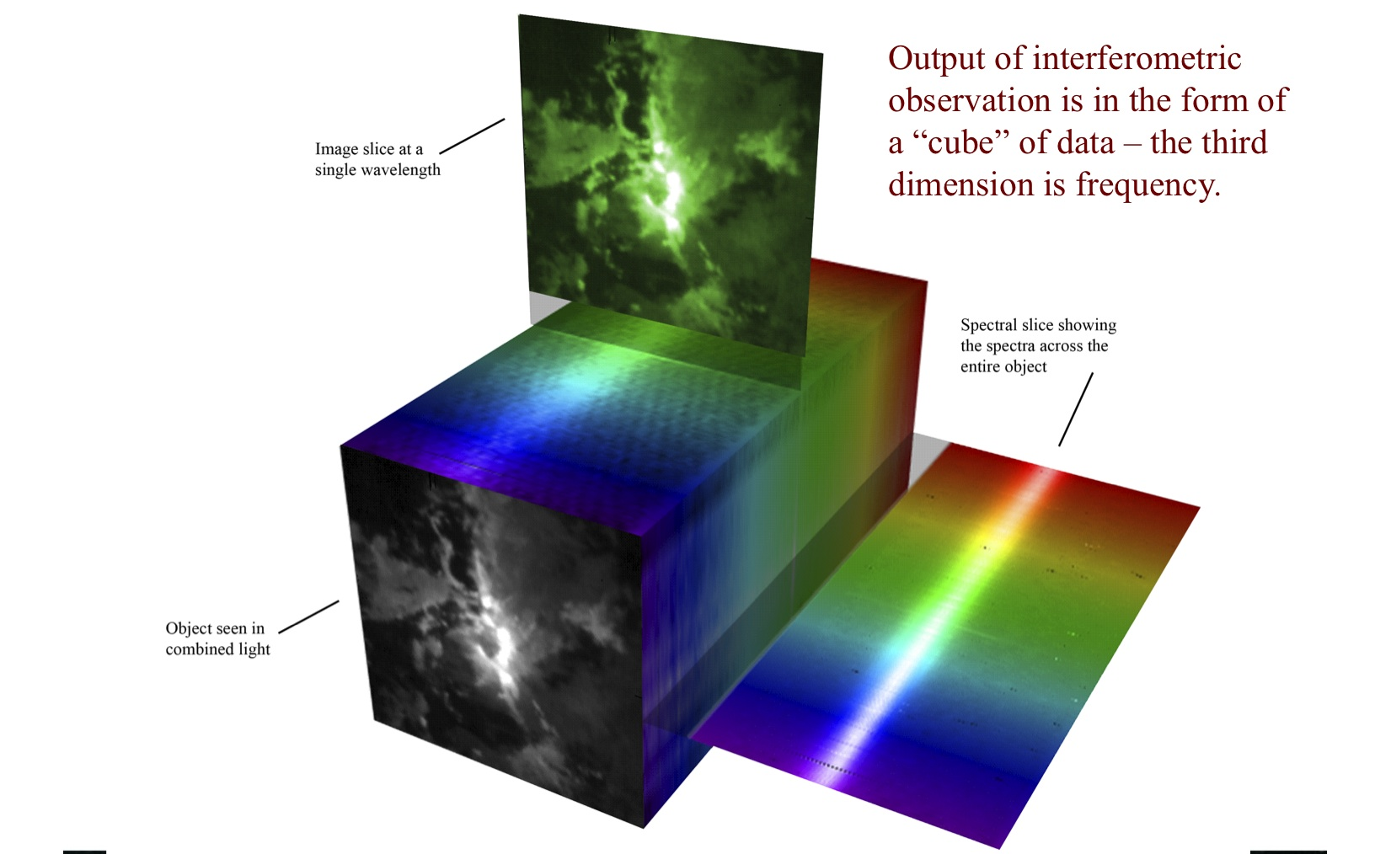
Slide credit Dr. Alison Peck

Slide 26
Star-forming gas clouds in two nearby galaxy mergers
The Antennae, the closest major merger
NGC 3256, the nearest luminous infrared galaxy
Angular resolution equivalent to 150 light years at distances of 75 to 150 million light years

Slide 27
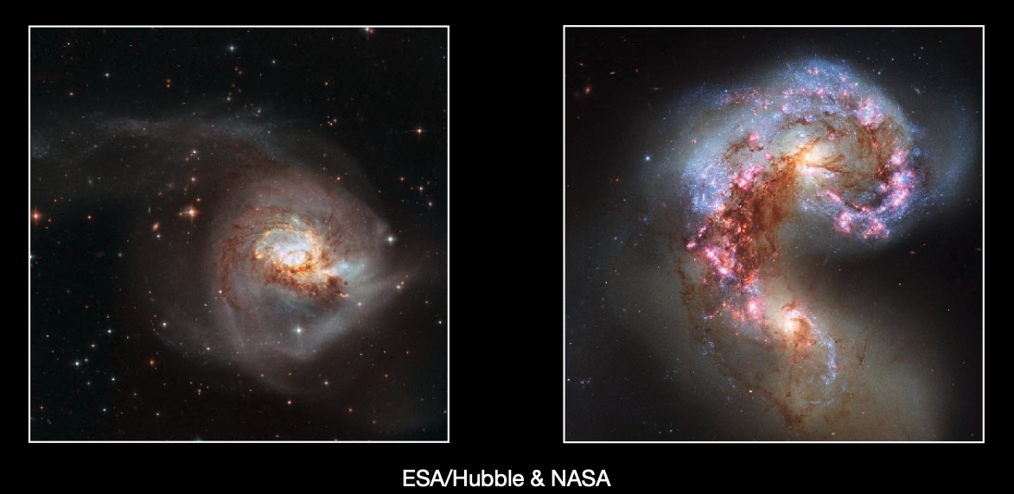
NGC 3256
The Antennae

Slide 28
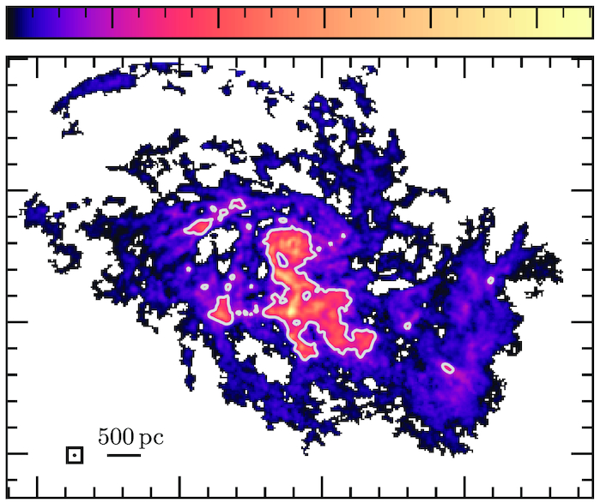
1000 2000 3000 4000 5000
Σ_{mol}
(M_{o}/pc²)
1500 l.y.
3000 l.y.
NGC 3256: Brunetti, Wilson, et al. 2021 Antennae: Brunetti, Wilson, et al., in prep.

Slide 29
3000 l.y.

Slide 30
Molecular gas on scales of 150 light years in the Antennae
the nearest major merger
  75 million light years distant
  Two similar-mass gas-rich spiral galaxies
Global star formation rate 10 M_{o}/yr
Two nuclei separated by ~15,000 l.y.
(Brunetti, Wilson, et al., in prep.)
3000 l.y.

Slide 31
Molecular gas on scales of 150 light years in NGC 3256
the nearest luminous infrared galaxy
  150 million light years distant
Global star formation rate 50 M_{o}/yr
Two nuclei separated by ~3000 l.y.
  Northern nucleus is a starburst
  Southern nucleus is an active galactic nucleus (a super massive black hole)
(Brunetti, Wilson, et al., 2021, MNRAS)
1500 l.y.

Slide 32
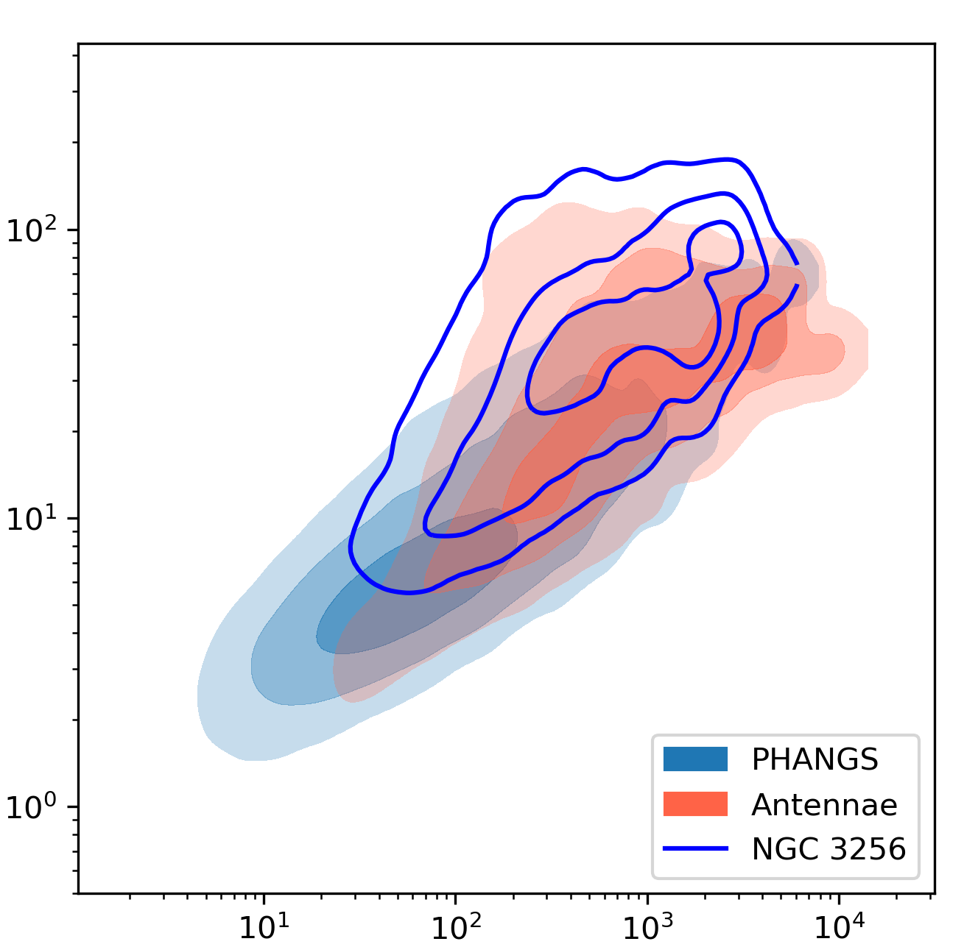
Higher gas mass and turbulent velocity in mergers than in normal spiral galaxies
500 l.y. resolution
Turbulent velocity (km/s)
Contours contain 99, 85, and 40% of the mass from each dataset
Gas mass per unit area
Brunetti et al. 2022, in prep.; PHANGS data: Sun et al. 2020

Slide 33
Using merger simulations to probe evolution of gas properties and star formation
Moreno et al. 2019

Slide 34
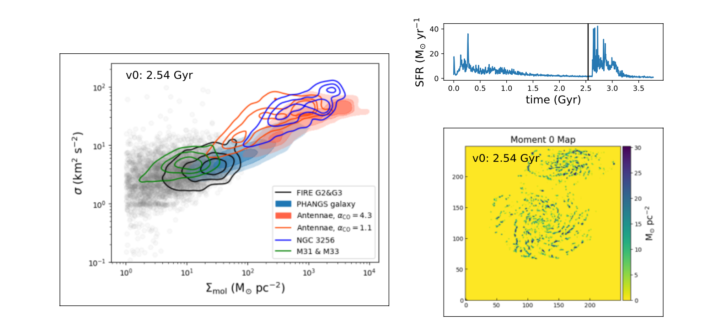
Snapshot at t = 2.54 Gyr
Hao He et al., 2023, in prep.
FIRE simulations: Moreno et al. 2019, MNRAS

Slide 35
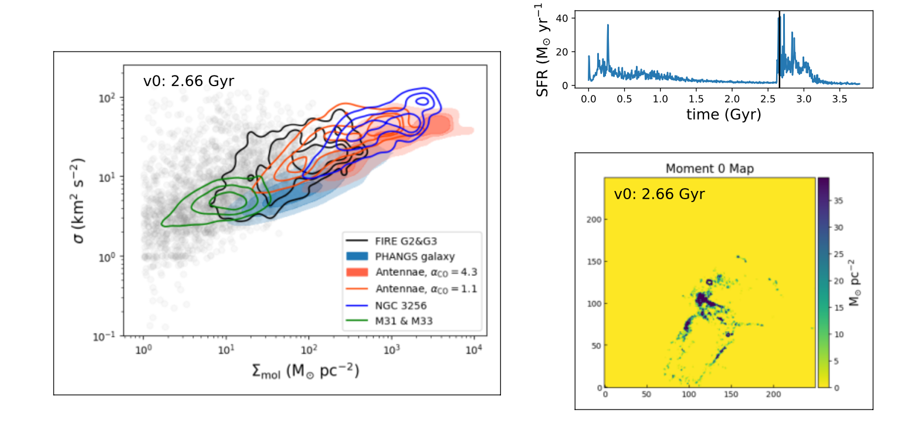
Snapshot at t = 2.66 Gyr
Hao He et al., 2023, in prep.
FIRE simulations: Moreno et al. 2019, MNRAS

Slide 36
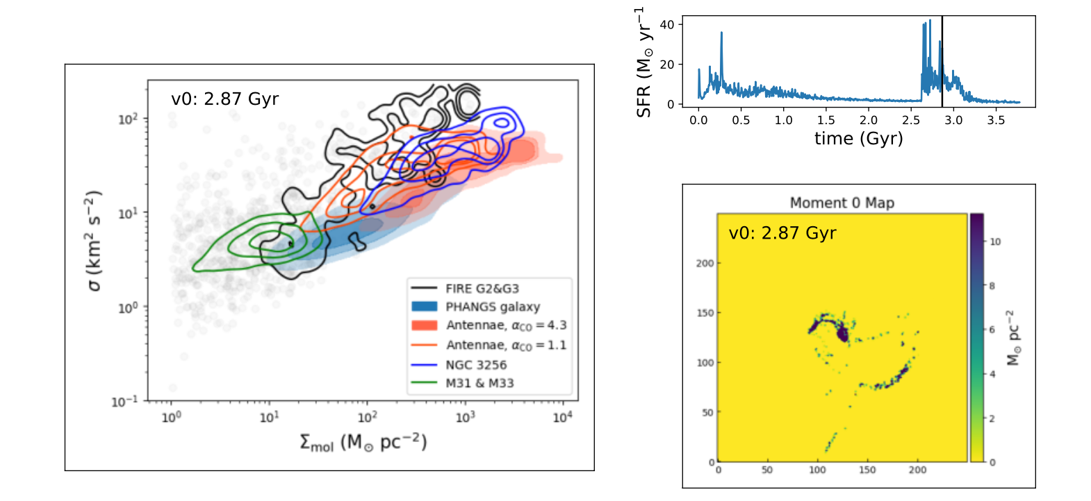
Snapshot at t = 2.87 Gyr
Hao He et al., 2023, in prep.
FIRE simulations: Moreno et al. 2019, MNRAS

Slide 37

A tale of two mergers …
NGC 3256: extremely high star formation rate, yet molecular clouds not bound by their own gravity
Antennae: star formation rate 1/5 that of NGC 3256, but higher gas surface densities
Is time evolution in mergers muddying the picture?

Slide 38
A tale of two mergers
Antennae here: high gas mass per unit area
→ Galaxies approach pericentre
→ Causes increase in gas mass/area
→ Triggers a high rate of star formation
→ Feedback unbinds the molecular gas
→ Causes the star formation rate to drop
NGC 3256 here: high star formation rate

Slide 39
Summary
Observing the sky at millimetre wavelengths lets us probe the cold, dense gas that is the fuel for star formation
  I started my career studying star-forming clouds in the nearest spiral galaxies
ALMA is a fantastically powerful telescope that after a decade in operation still produces surprises
My recent work on merging galaxies has revealed gas clouds with significantly different properties than clouds in normal spiral galaxies
  These changes in cloud properties are likely linked to the high star formation rate seen in mergers
  But rapid time evolution in gas and star formation during the merger phase complicates the analysis

Slide 40
3000 l.y.

